Slide 1
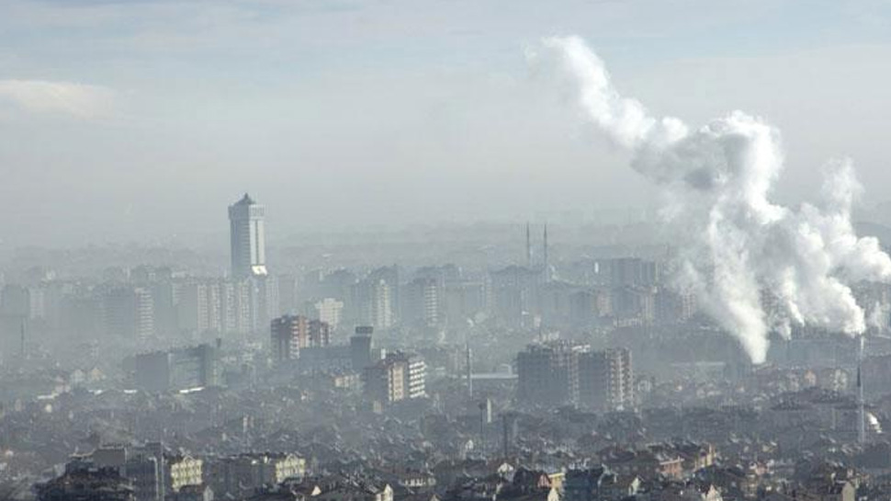
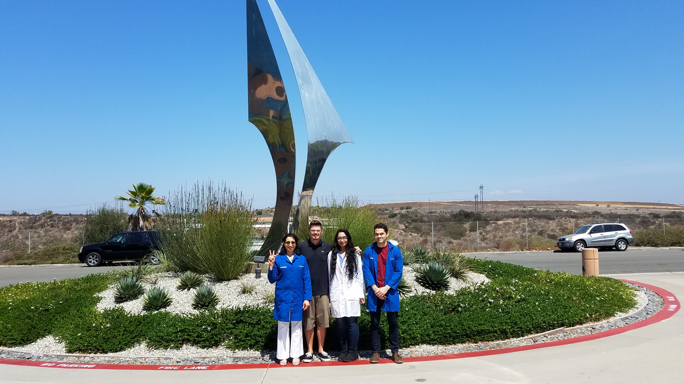
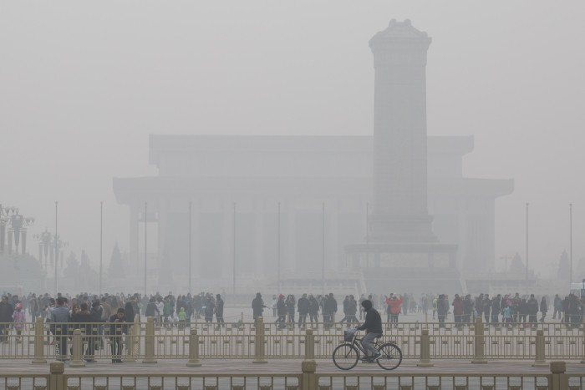
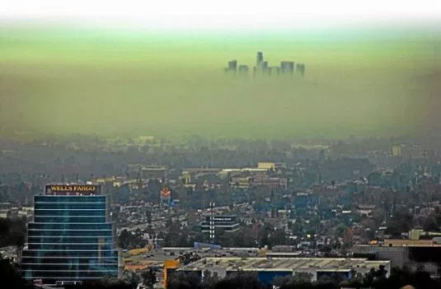
“Air pollution is linked to mortality?”
Finding answers with Real Time Data Analysis
Delhi, India 2018
Google search ~ 15,600,000 results
Research papers ~ 9038
UCSD ext- SD, 08182018
Beijing, China 2017
LA, USA, 1995
UCSD Data visualization Bootcamp, DATA20180619
Notes:
Tropospheric ozone is a secondary pollutant, it is not emitted directly but instead is produced photochemically in the troposphere by its precursors such as reactive nitrogen oxide (NOx), CO, CH4 and VOC’s. Life time of an ozone molecule in the troposphere varies according to the photochemical activity ( a mean tropospheric life time is ~22days). Ozone has a longer life time in the free and cold troposphere than warmer boundary layer.
difference between stratospheric and tropospheric ozone generation is in the source of atomic O
for solar radiation with a wavelength of less than 242 nm:
O₂ + hv  O + O
photochemical production of O₃ in troposphere tied to NO_{x} (NO + NO₂)
for wavelengths less than 424 nm:
NO₂ + hv  NO + O
but NO will react with O₃
NO + O₃  NO₂
presence of peroxy radicals, from the oxidation of hydrocarbons, disturbs O₃-NO-NO₂ cycle
NO + HO₂·  NO₂ + OH·
NO + RO₂·  NO₂ + RO·
leads to net production of ozone
The ozone molecule has four resonance structure which imparts or confer a slight polarity to the ozone molecule (0.53D).
The bond length 1.272A is intermediate b/w double bond 1.21A and single bond (H-O) 1.47A {angstroms (A)}.
Protective shield in the stratosphere
Strong oxidant
Secondary pollutant in the troposphere
3rd most abundant GHG with RF +0.3 W.m-2
Damage crops and property
Cause respiratory diseases and premature mortality

Slide 2
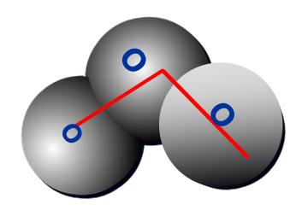
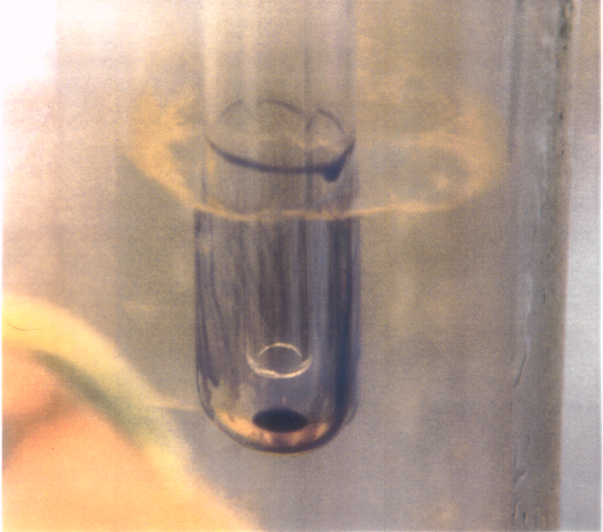
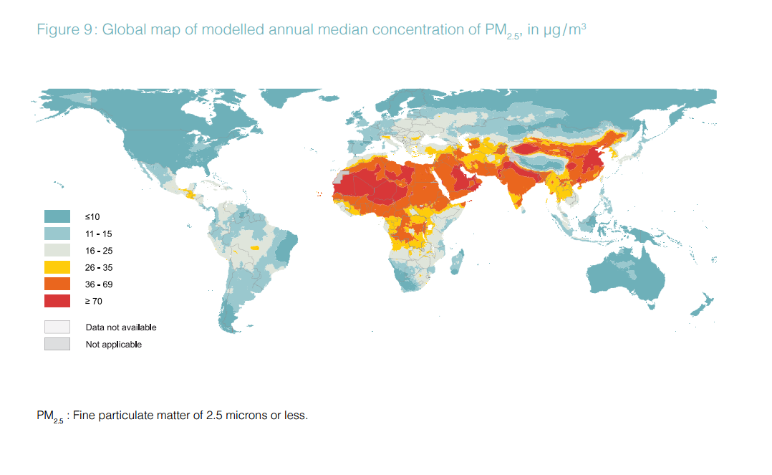
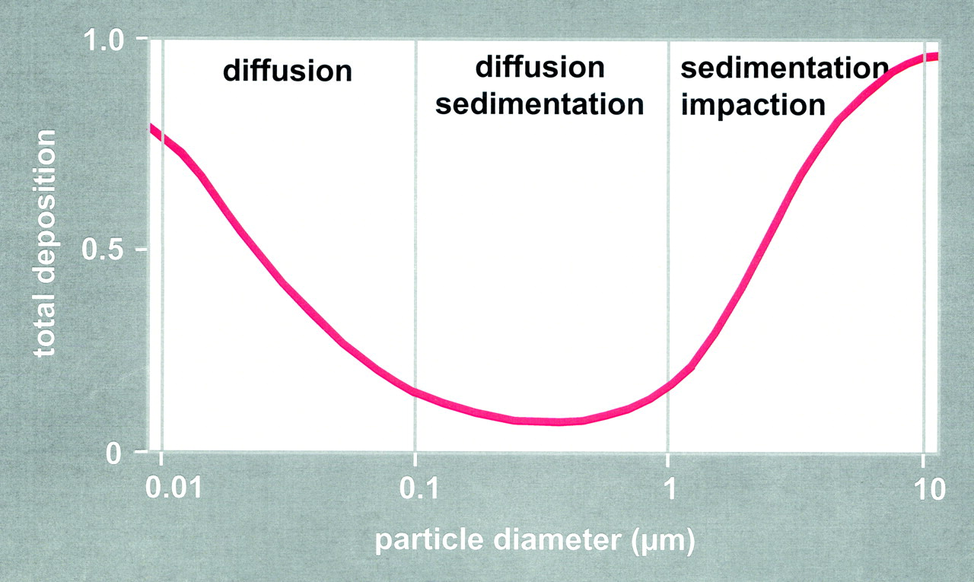
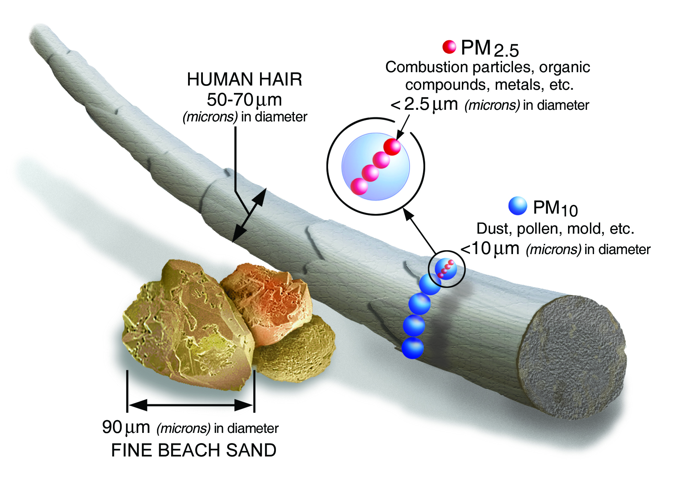
Hypothesis1: Ozone is responsible for higher asthma rates in polluted areas.
Ozone is a strong oxidant and exist in the gas phase.
Inhaled ozone interact with protein, lipids and can damage at cellular level.
Background ozone in clean environment = 20ppb
Polluted environment = 40-100ppb.
O
Hypothesis 2: Particulate matter (PM2.5) is responsible for higher asthma rates.
UCSD Data visualization Bootcamp, DATA20180619
Notes:
Tropospheric ozone is a secondary pollutant, it is not emitted directly but instead is produced photochemically in the troposphere by its precursors such as reactive nitrogen oxide (NOx), CO, CH4 and VOC’s. Life time of an ozone molecule in the troposphere varies according to the photochemical activity ( a mean tropospheric life time is ~22days). Ozone has a longer life time in the free and cold troposphere than warmer boundary layer.
difference between stratospheric and tropospheric ozone generation is in the source of atomic O
for solar radiation with a wavelength of less than 242 nm:
O₂ + hv  O + O
photochemical production of O₃ in troposphere tied to NO_{x} (NO + NO₂)
for wavelengths less than 424 nm:
NO₂ + hv  NO + O
but NO will react with O₃
NO + O₃  NO₂
presence of peroxy radicals, from the oxidation of hydrocarbons, disturbs O₃-NO-NO₂ cycle
NO + HO₂·  NO₂ + OH·
NO + RO₂·  NO₂ + RO·
leads to net production of ozone
The ozone molecule has four resonance structure which imparts or confer a slight polarity to the ozone molecule (0.53D).
The bond length 1.272A is intermediate b/w double bond 1.21A and single bond (H-O) 1.47A {angstroms (A)}.
Protective shield in the stratosphere
Strong oxidant
Secondary pollutant in the troposphere
3rd most abundant GHG with RF +0.3 W.m-2
Damage crops and property
Cause respiratory diseases and premature mortality

Slide 3

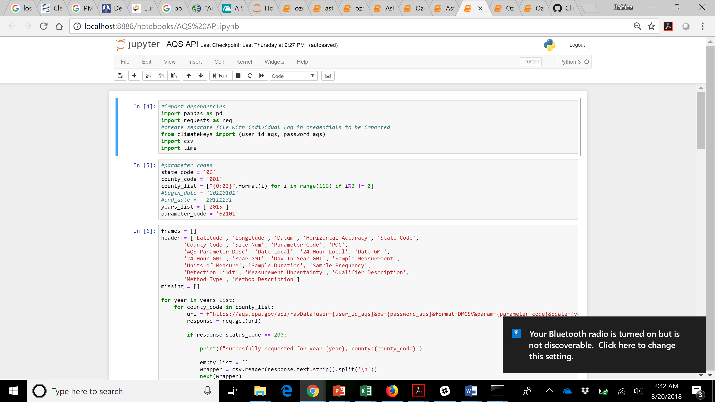
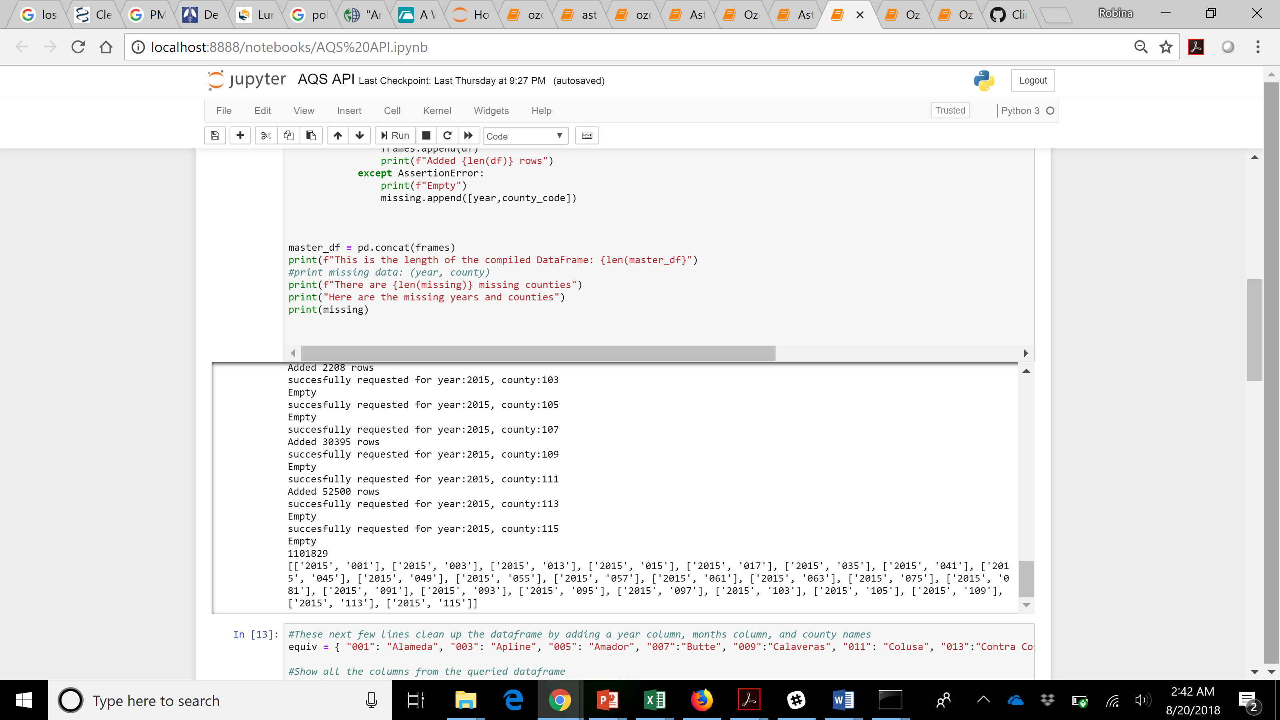
Data Acquistion?
State of CA: Champion in clean air standards and have maximum sensors across all counties
EPA, Air Now, Data.gov, ARB etc.
Caveats of metadata:
Tedious job for each county, year, parameter i.e. pollutant
Caveats of metadata: Missing values (25 counties)
counties in CA= 58
Notes:
Tropospheric ozone is a secondary pollutant, it is not emitted directly but instead is produced photochemically in the troposphere by its precursors such as reactive nitrogen oxide (NOx), CO, CH4 and VOC’s. Life time of an ozone molecule in the troposphere varies according to the photochemical activity ( a mean tropospheric life time is ~22days). Ozone has a longer life time in the free and cold troposphere than warmer boundary layer.
difference between stratospheric and tropospheric ozone generation is in the source of atomic O
for solar radiation with a wavelength of less than 242 nm:
O₂ + hv  O + O
photochemical production of O₃ in troposphere tied to NO_{x} (NO + NO₂)
for wavelengths less than 424 nm:
NO₂ + hv  NO + O
but NO will react with O₃
NO + O₃  NO₂
presence of peroxy radicals, from the oxidation of hydrocarbons, disturbs O₃-NO-NO₂ cycle
NO + HO₂·  NO₂ + OH·
NO + RO₂·  NO₂ + RO·
leads to net production of ozone
The ozone molecule has four resonance structure which imparts or confer a slight polarity to the ozone molecule (0.53D).
The bond length 1.272A is intermediate b/w double bond 1.21A and single bond (H-O) 1.47A {angstroms (A)}.
Protective shield in the stratosphere
Strong oxidant
Secondary pollutant in the troposphere
3rd most abundant GHG with RF +0.3 W.m-2
Damage crops and property
Cause respiratory diseases and premature mortality

Slide 4
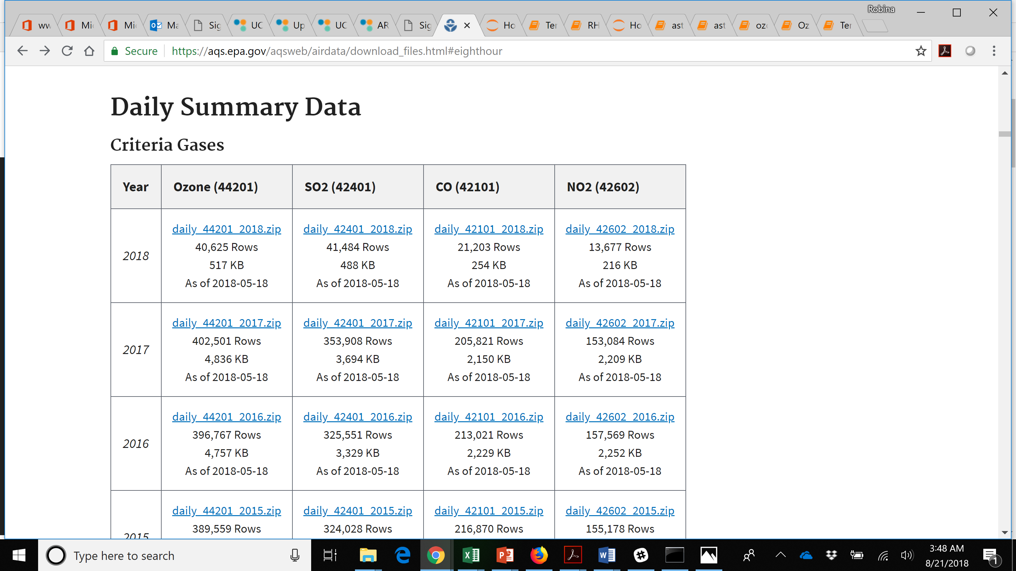
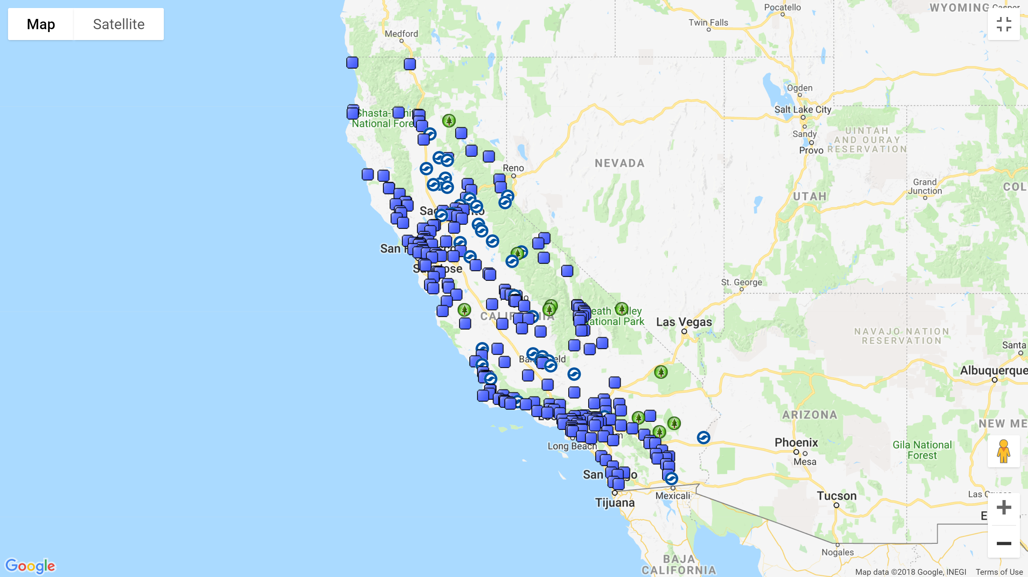
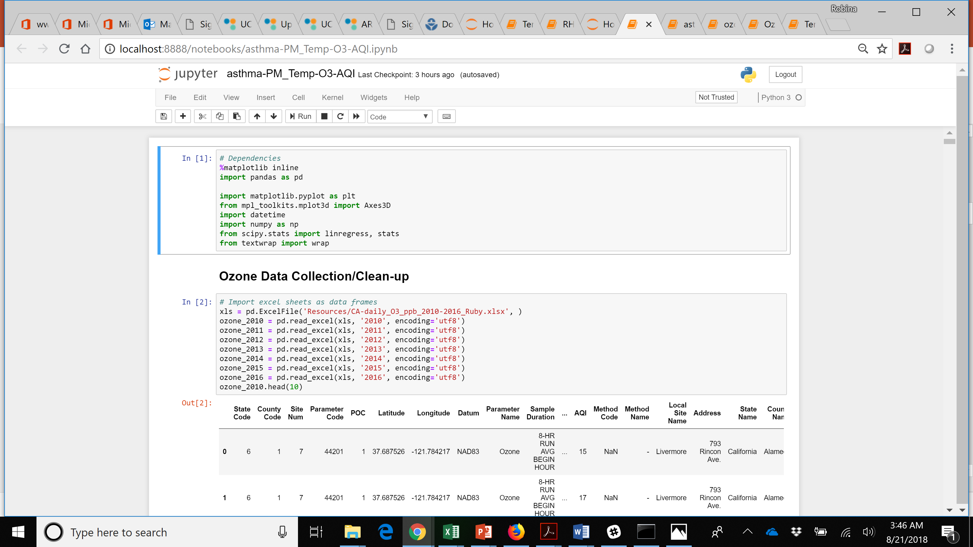
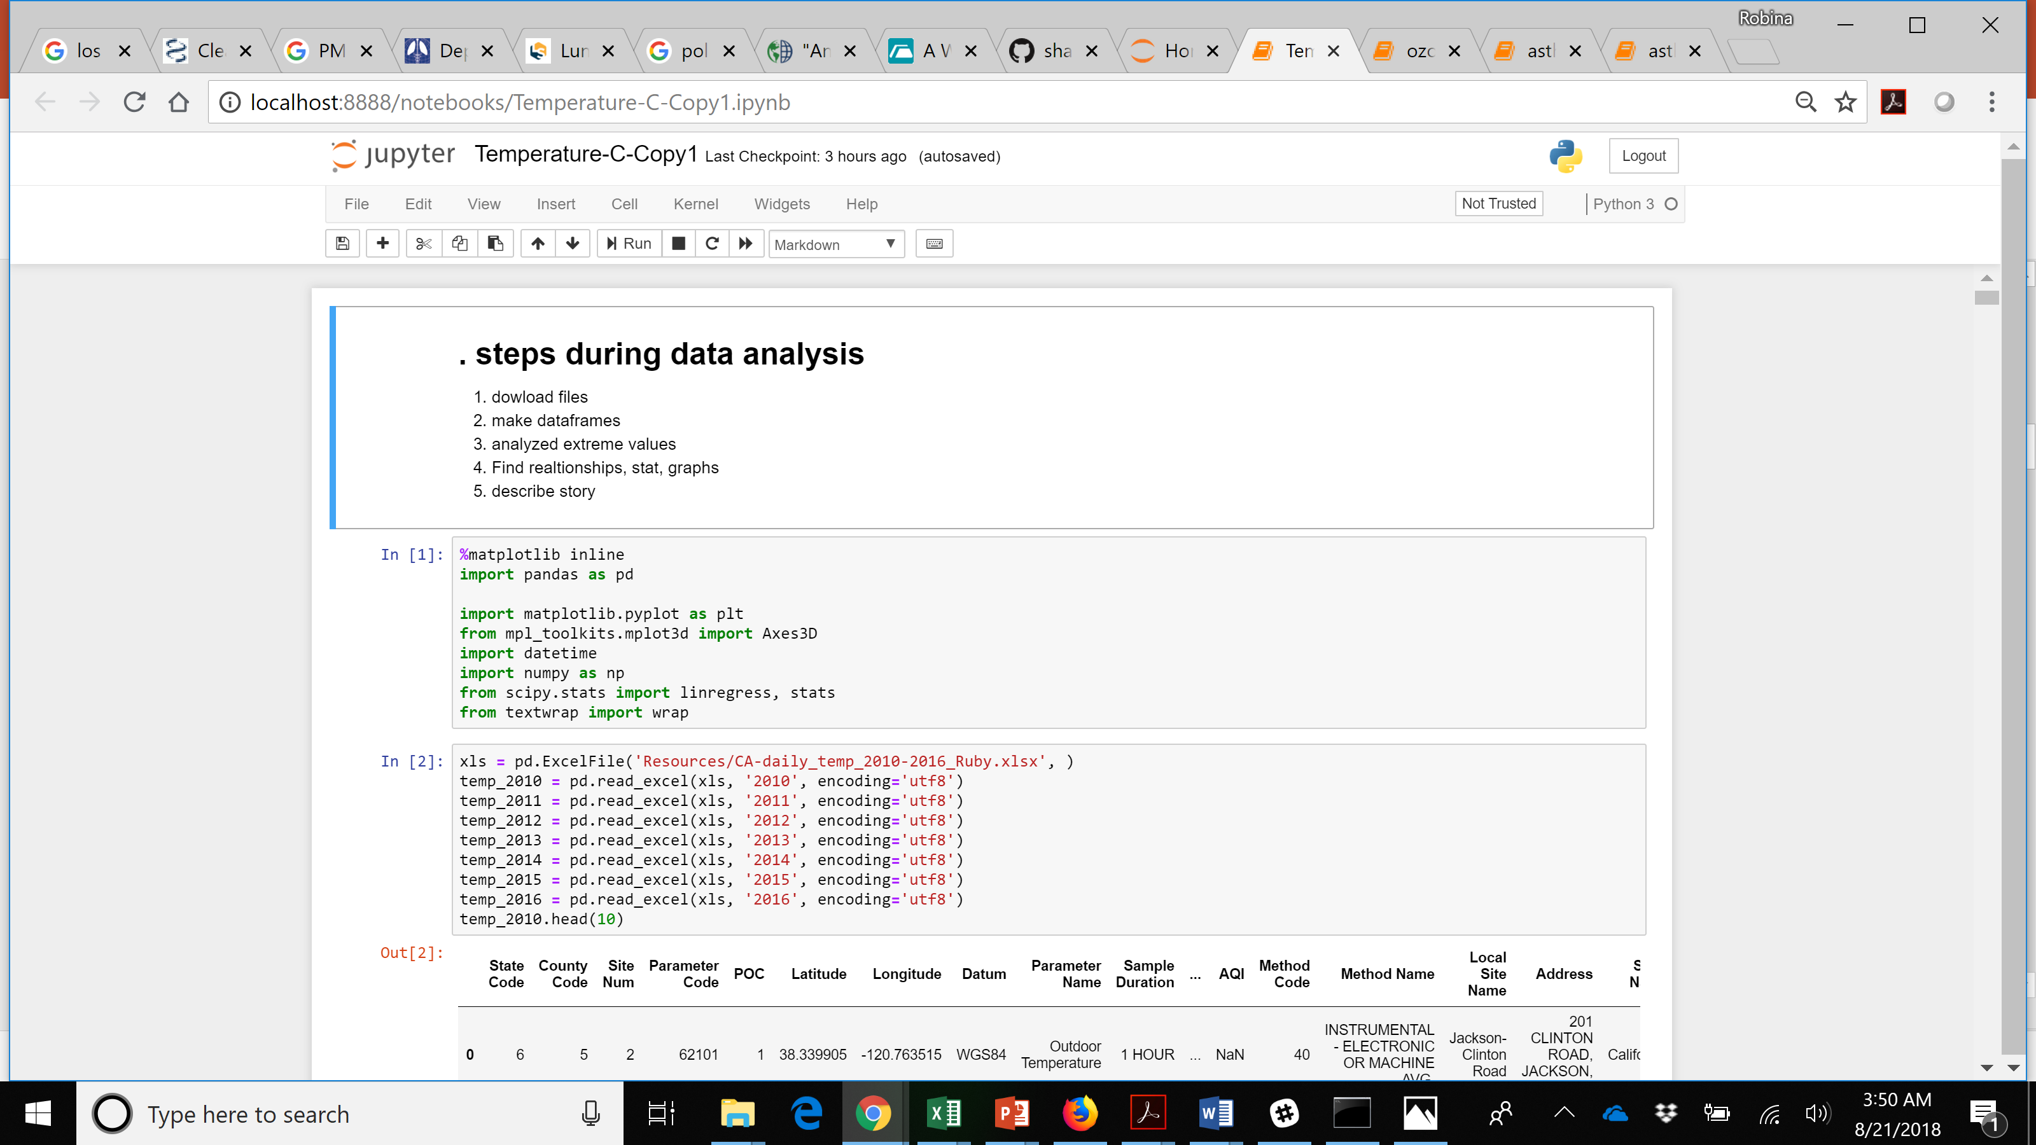
Enormous Data for the entire USA
Each file ~ 1.2 MB
changed to DataFrames using Panda/Jupyter notebook
UCSD Data visualization Bootcamp, DATA20180619
Notes:
Tropospheric ozone is a secondary pollutant, it is not emitted directly but instead is produced photochemically in the troposphere by its precursors such as reactive nitrogen oxide (NOx), CO, CH4 and VOC’s. Life time of an ozone molecule in the troposphere varies according to the photochemical activity ( a mean tropospheric life time is ~22days). Ozone has a longer life time in the free and cold troposphere than warmer boundary layer.
difference between stratospheric and tropospheric ozone generation is in the source of atomic O
for solar radiation with a wavelength of less than 242 nm:
O₂ + hv  O + O
photochemical production of O₃ in troposphere tied to NO_{x} (NO + NO₂)
for wavelengths less than 424 nm:
NO₂ + hv  NO + O
but NO will react with O₃
NO + O₃  NO₂
presence of peroxy radicals, from the oxidation of hydrocarbons, disturbs O₃-NO-NO₂ cycle
NO + HO₂·  NO₂ + OH·
NO + RO₂·  NO₂ + RO·
leads to net production of ozone
The ozone molecule has four resonance structure which imparts or confer a slight polarity to the ozone molecule (0.53D).
The bond length 1.272A is intermediate b/w double bond 1.21A and single bond (H-O) 1.47A {angstroms (A)}.
Protective shield in the stratosphere
Strong oxidant
Secondary pollutant in the troposphere
3rd most abundant GHG with RF +0.3 W.m-2
Damage crops and property
Cause respiratory diseases and premature mortality

Slide 5
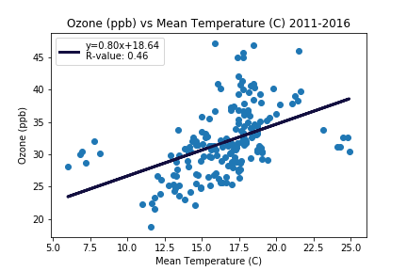
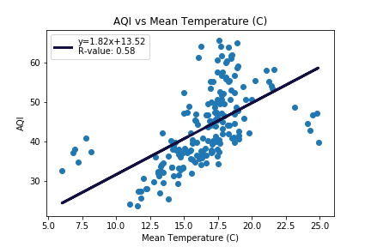
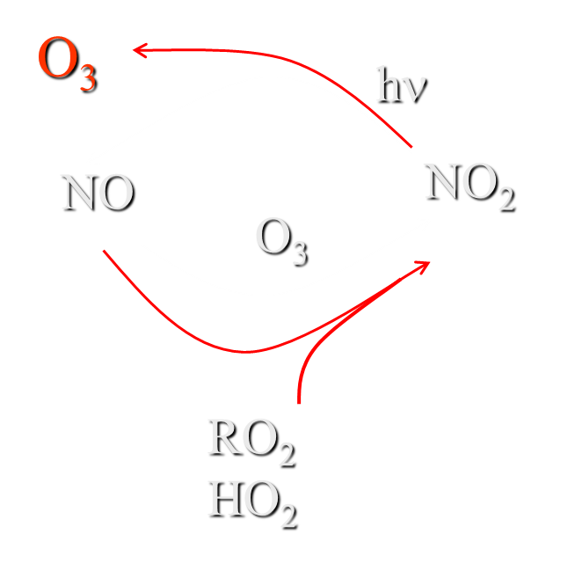
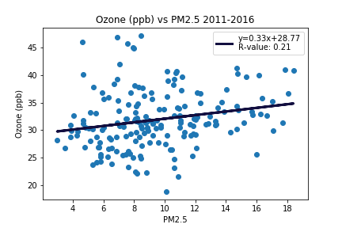
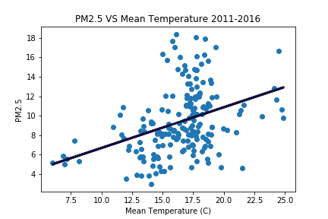

AQI=O₃, SO₂, NO_{x}, CO, PM_{2.5}, PM₁₀
UCSD Data visualization Bootcamp, DATA20180619
Notes:
Tropospheric ozone is a secondary pollutant, it is not emitted directly but instead is produced photochemically in the troposphere by its precursors such as reactive nitrogen oxide (NOx), CO, CH4 and VOC’s. Life time of an ozone molecule in the troposphere varies according to the photochemical activity ( a mean tropospheric life time is ~22days). Ozone has a longer life time in the free and cold troposphere than warmer boundary layer.
difference between stratospheric and tropospheric ozone generation is in the source of atomic O
for solar radiation with a wavelength of less than 242 nm:
O₂ + hv  O + O
photochemical production of O₃ in troposphere tied to NO_{x} (NO + NO₂)
for wavelengths less than 424 nm:
NO₂ + hv  NO + O
but NO will react with O₃
NO + O₃  NO₂
presence of peroxy radicals, from the oxidation of hydrocarbons, disturbs O₃-NO-NO₂ cycle
NO + HO₂·  NO₂ + OH·
NO + RO₂·  NO₂ + RO·
leads to net production of ozone
The ozone molecule has four resonance structure which imparts or confer a slight polarity to the ozone molecule (0.53D).
The bond length 1.272A is intermediate b/w double bond 1.21A and single bond (H-O) 1.47A {angstroms (A)}.
Protective shield in the stratosphere
Strong oxidant
Secondary pollutant in the troposphere
3rd most abundant GHG with RF +0.3 W.m-2
Damage crops and property
Cause respiratory diseases and premature mortality

Slide 6
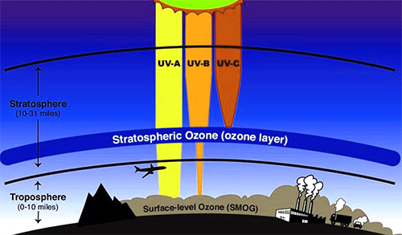
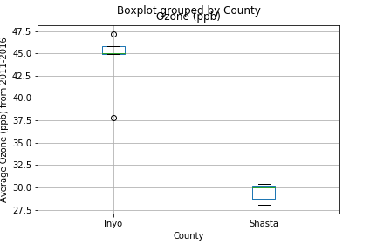
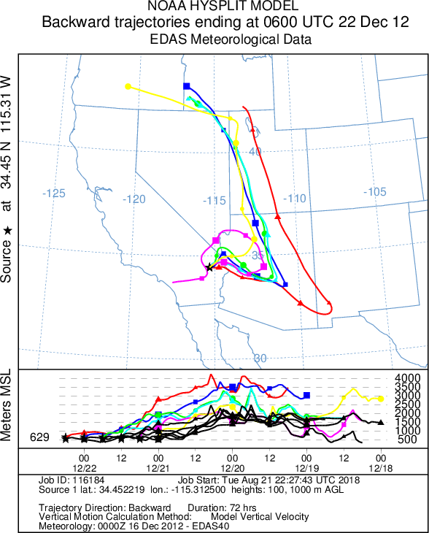
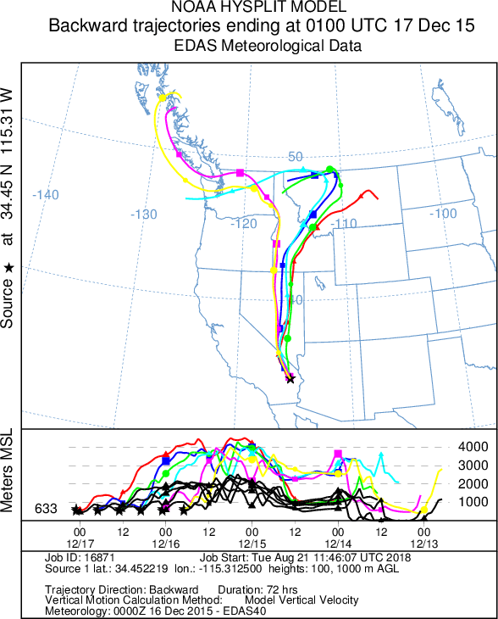
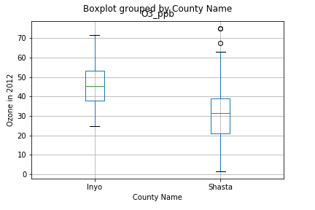
https://ready.arl.noaa.gov/hypub-bin/traj1.pl
Notes:
Tropospheric ozone is a secondary pollutant, it is not emitted directly but instead is produced photochemically in the troposphere by its precursors such as reactive nitrogen oxide (NOx), CO, CH4 and VOC’s. Life time of an ozone molecule in the troposphere varies according to the photochemical activity ( a mean tropospheric life time is ~22days). Ozone has a longer life time in the free and cold troposphere than warmer boundary layer.
difference between stratospheric and tropospheric ozone generation is in the source of atomic O
for solar radiation with a wavelength of less than 242 nm:
O₂ + hv  O + O
photochemical production of O₃ in troposphere tied to NO_{x} (NO + NO₂)
for wavelengths less than 424 nm:
NO₂ + hv  NO + O
but NO will react with O₃
NO + O₃  NO₂
presence of peroxy radicals, from the oxidation of hydrocarbons, disturbs O₃-NO-NO₂ cycle
NO + HO₂·  NO₂ + OH·
NO + RO₂·  NO₂ + RO·
leads to net production of ozone
The ozone molecule has four resonance structure which imparts or confer a slight polarity to the ozone molecule (0.53D).
The bond length 1.272A is intermediate b/w double bond 1.21A and single bond (H-O) 1.47A {angstroms (A)}.
Protective shield in the stratosphere
Strong oxidant
Secondary pollutant in the troposphere
3rd most abundant GHG with RF +0.3 W.m-2
Damage crops and property
Cause respiratory diseases and premature mortality

Slide 7
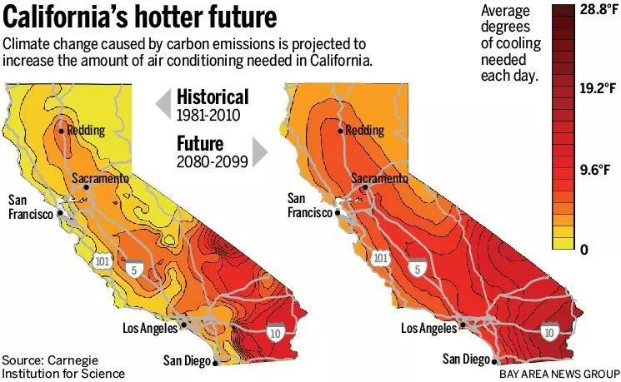
Notes:
Tropospheric ozone is a secondary pollutant, it is not emitted directly but instead is produced photochemically in the troposphere by its precursors such as reactive nitrogen oxide (NOx), CO, CH4 and VOC’s. Life time of an ozone molecule in the troposphere varies according to the photochemical activity ( a mean tropospheric life time is ~22days). Ozone has a longer life time in the free and cold troposphere than warmer boundary layer.
difference between stratospheric and tropospheric ozone generation is in the source of atomic O
for solar radiation with a wavelength of less than 242 nm:
O₂ + hv  O + O
photochemical production of O₃ in troposphere tied to NO_{x} (NO + NO₂)
for wavelengths less than 424 nm:
NO₂ + hv  NO + O
but NO will react with O₃
NO + O₃  NO₂
presence of peroxy radicals, from the oxidation of hydrocarbons, disturbs O₃-NO-NO₂ cycle
NO + HO₂·  NO₂ + OH·
NO + RO₂·  NO₂ + RO·
leads to net production of ozone
The ozone molecule has four resonance structure which imparts or confer a slight polarity to the ozone molecule (0.53D).
The bond length 1.272A is intermediate b/w double bond 1.21A and single bond (H-O) 1.47A {angstroms (A)}.
Protective shield in the stratosphere
Strong oxidant
Secondary pollutant in the troposphere
3rd most abundant GHG with RF +0.3 W.m-2
Damage crops and property
Cause respiratory diseases and premature mortality

Slide 8
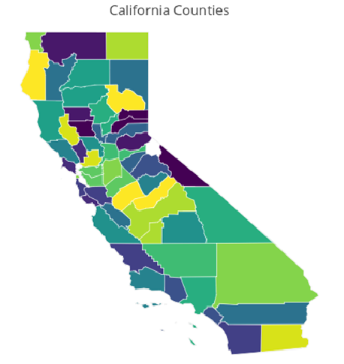
Data Collection Using EPA API
(https://aqs.epa.gov/api)
Nested For Loop
County code
Year
001
003
005
007
…
115
[ DataFrame ]
Parameter of
interest
2011
2012
2013
2014
2015
2016
[ DF1,
DF2,
DF3,
…,
DFi ]
CO2
Ozone
PM2.5
PM10
Wind Speed
Temp
Humidity
[ Master DF ]
~ 3.5 x 10^6 Rows
~ 3 hours of querying
Notes:
Tropospheric ozone is a secondary pollutant, it is not emitted directly but instead is produced photochemically in the troposphere by its precursors such as reactive nitrogen oxide (NOx), CO, CH4 and VOC’s. Life time of an ozone molecule in the troposphere varies according to the photochemical activity ( a mean tropospheric life time is ~22days). Ozone has a longer life time in the free and cold troposphere than warmer boundary layer.
difference between stratospheric and tropospheric ozone generation is in the source of atomic O
for solar radiation with a wavelength of less than 242 nm:
O₂ + hv  O + O
photochemical production of O₃ in troposphere tied to NO_{x} (NO + NO₂)
for wavelengths less than 424 nm:
NO₂ + hv  NO + O
but NO will react with O₃
NO + O₃  NO₂
presence of peroxy radicals, from the oxidation of hydrocarbons, disturbs O₃-NO-NO₂ cycle
NO + HO₂·  NO₂ + OH·
NO + RO₂·  NO₂ + RO·
leads to net production of ozone
The ozone molecule has four resonance structure which imparts or confer a slight polarity to the ozone molecule (0.53D).
The bond length 1.272A is intermediate b/w double bond 1.21A and single bond (H-O) 1.47A {angstroms (A)}.
Protective shield in the stratosphere
Strong oxidant
Secondary pollutant in the troposphere
3rd most abundant GHG with RF +0.3 W.m-2
Damage crops and property
Cause respiratory diseases and premature mortality

Slide 9
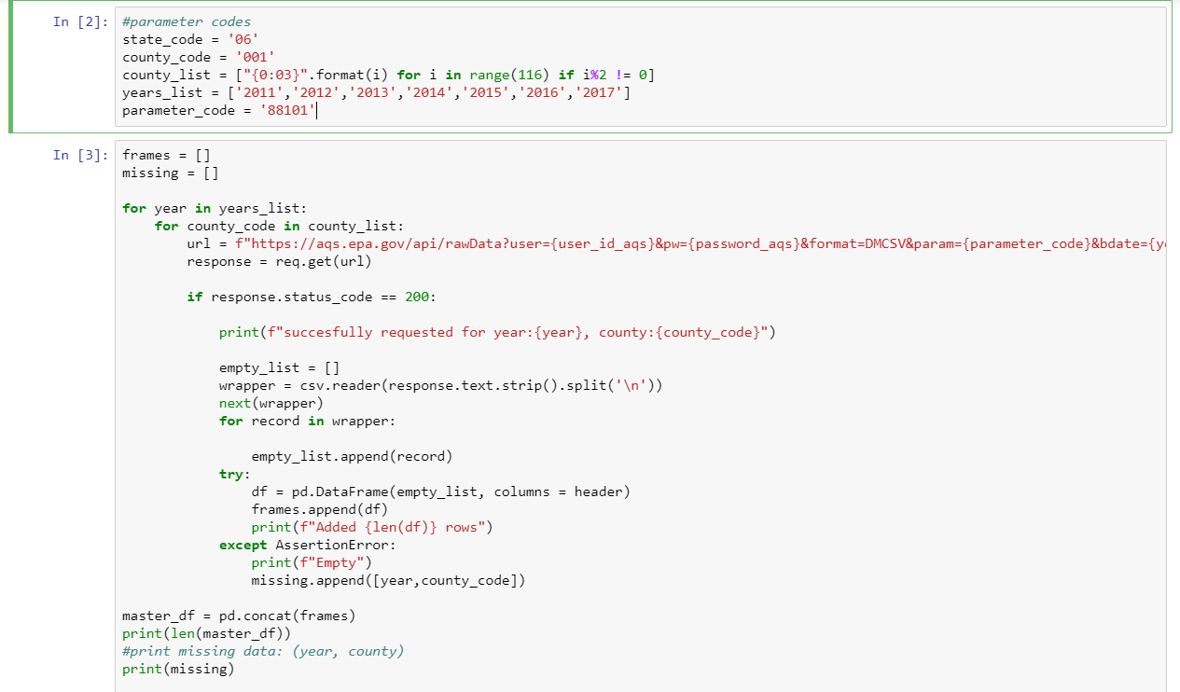
Notes:
Tropospheric ozone is a secondary pollutant, it is not emitted directly but instead is produced photochemically in the troposphere by its precursors such as reactive nitrogen oxide (NOx), CO, CH4 and VOC’s. Life time of an ozone molecule in the troposphere varies according to the photochemical activity ( a mean tropospheric life time is ~22days). Ozone has a longer life time in the free and cold troposphere than warmer boundary layer.
difference between stratospheric and tropospheric ozone generation is in the source of atomic O
for solar radiation with a wavelength of less than 242 nm:
O₂ + hv  O + O
photochemical production of O₃ in troposphere tied to NO_{x} (NO + NO₂)
for wavelengths less than 424 nm:
NO₂ + hv  NO + O
but NO will react with O₃
NO + O₃  NO₂
presence of peroxy radicals, from the oxidation of hydrocarbons, disturbs O₃-NO-NO₂ cycle
NO + HO₂·  NO₂ + OH·
NO + RO₂·  NO₂ + RO·
leads to net production of ozone
The ozone molecule has four resonance structure which imparts or confer a slight polarity to the ozone molecule (0.53D).
The bond length 1.272A is intermediate b/w double bond 1.21A and single bond (H-O) 1.47A {angstroms (A)}.
Protective shield in the stratosphere
Strong oxidant
Secondary pollutant in the troposphere
3rd most abundant GHG with RF +0.3 W.m-2
Damage crops and property
Cause respiratory diseases and premature mortality

Slide 10
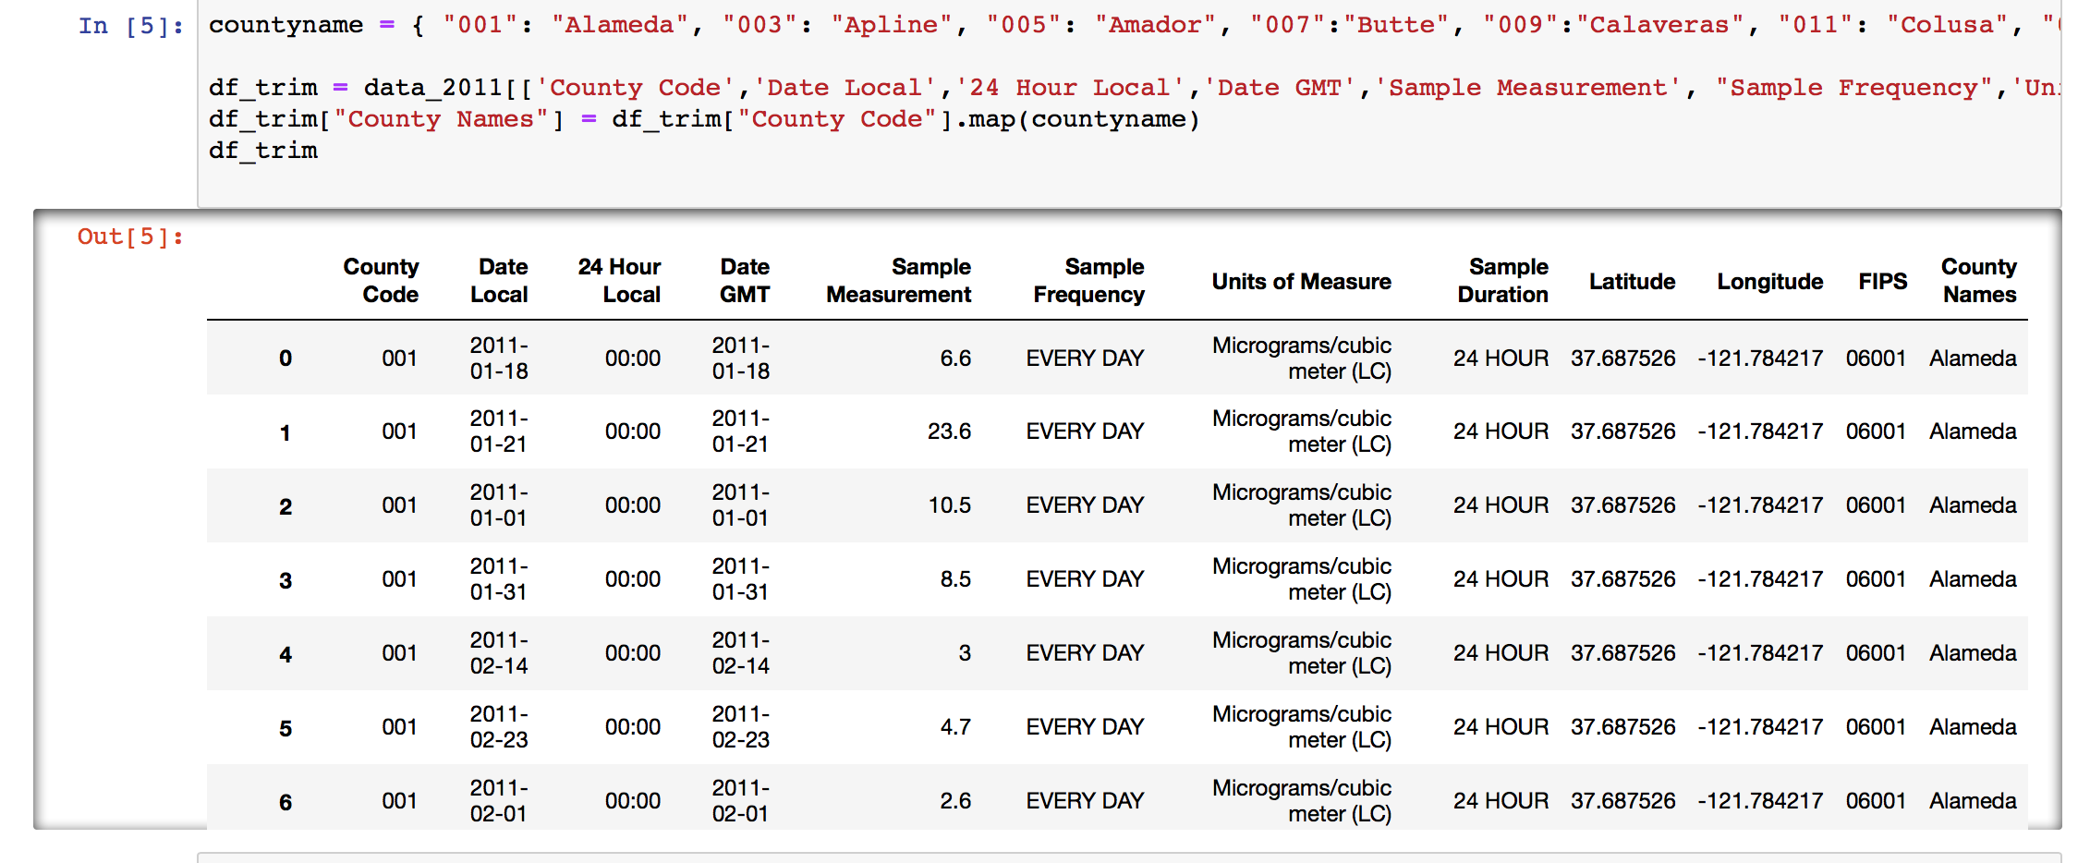
Data Cleaning: ☹
Created a dictionary with County Names and County Codes to map to new column in DataFrame.
And trimmed off non-essential columns.

Slide 11
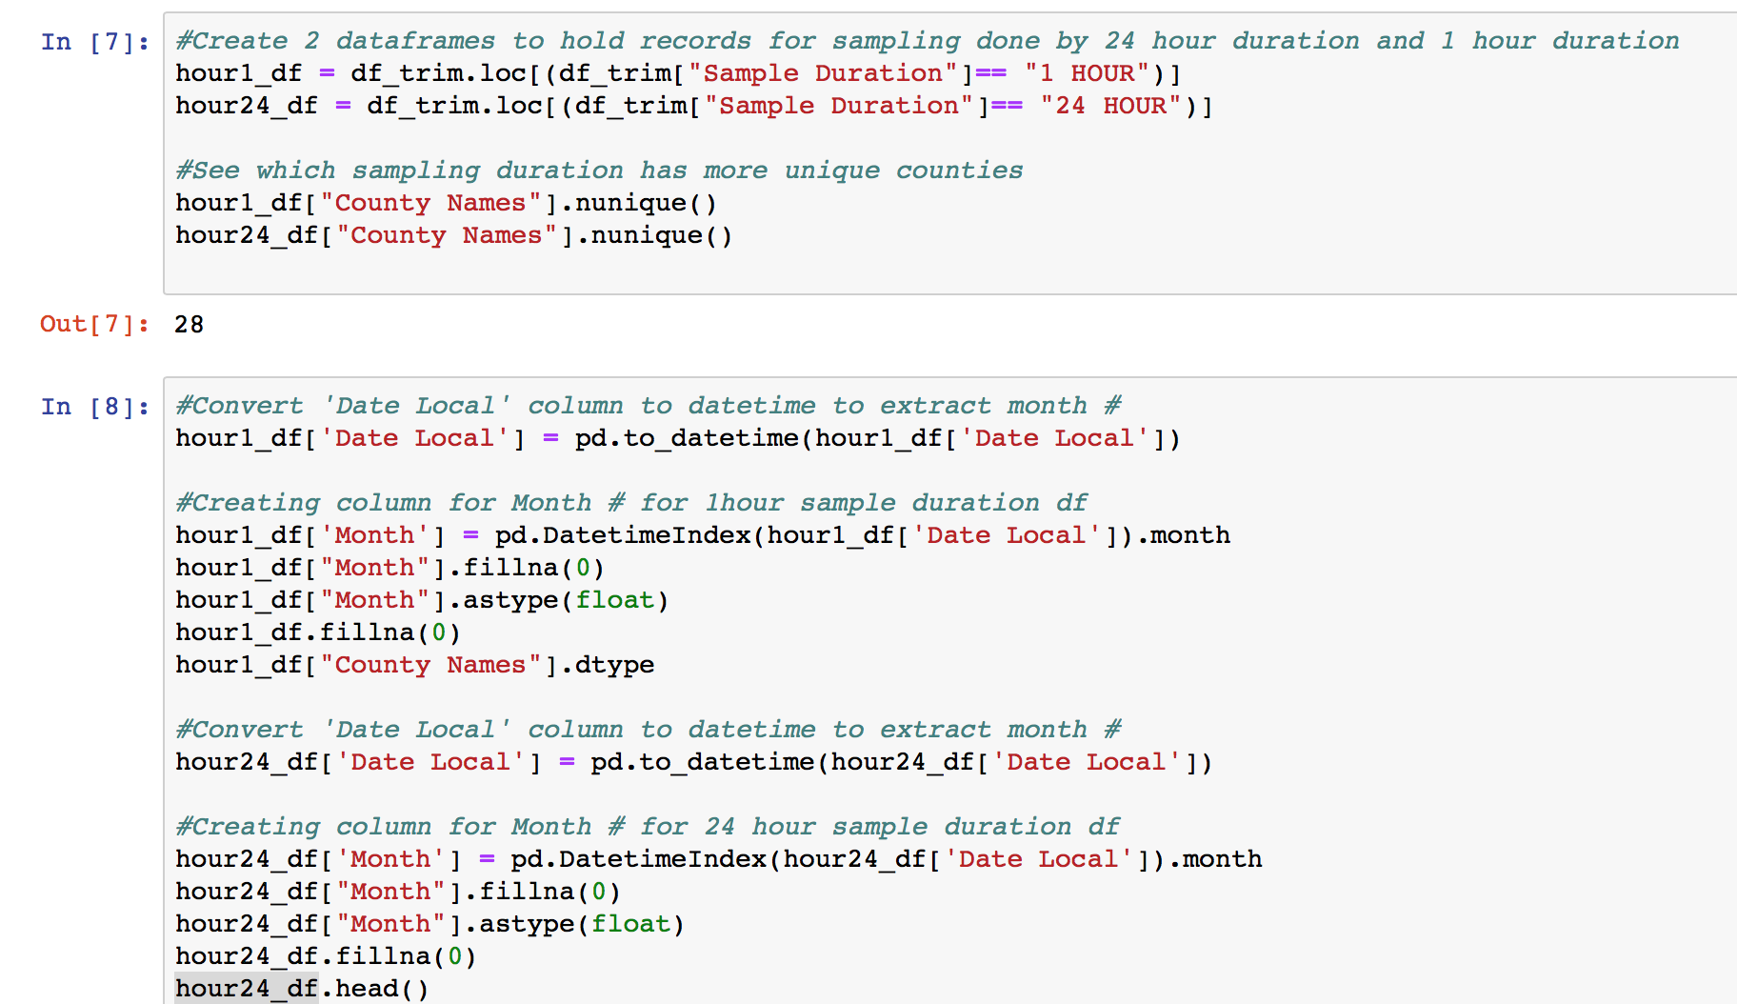
More Cleaning:
-Created 2 Data Frames to look at data gathered by “24 hour sampling” duration and “1 hour Sampling duration.
-Mapped month value from date column to separate column to analyze trends over the course of the year

Slide 12
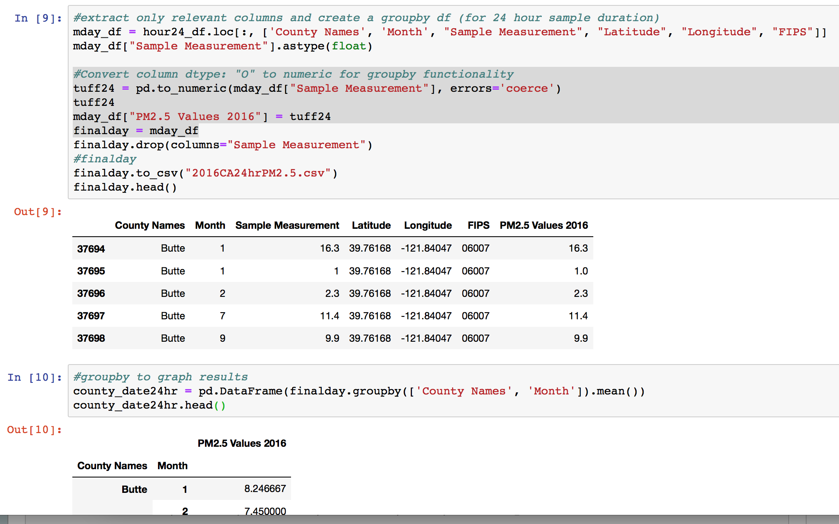
Limpiando Mas
Because “Sample Measurement” Data was returned from API as data type “O” or “Object, it had to be converted to float format in order to be used in “Groupby” function.
df[“column name”].dtype <= will return data type of column values
pd.to_numeric(df[“column name”], errors=“coerce”) <= will convert “obj” to numeric/float type
Than was able to groupby (“County Name” And “Month) to get PM2.5 AVG per month of each year.

Slide 13
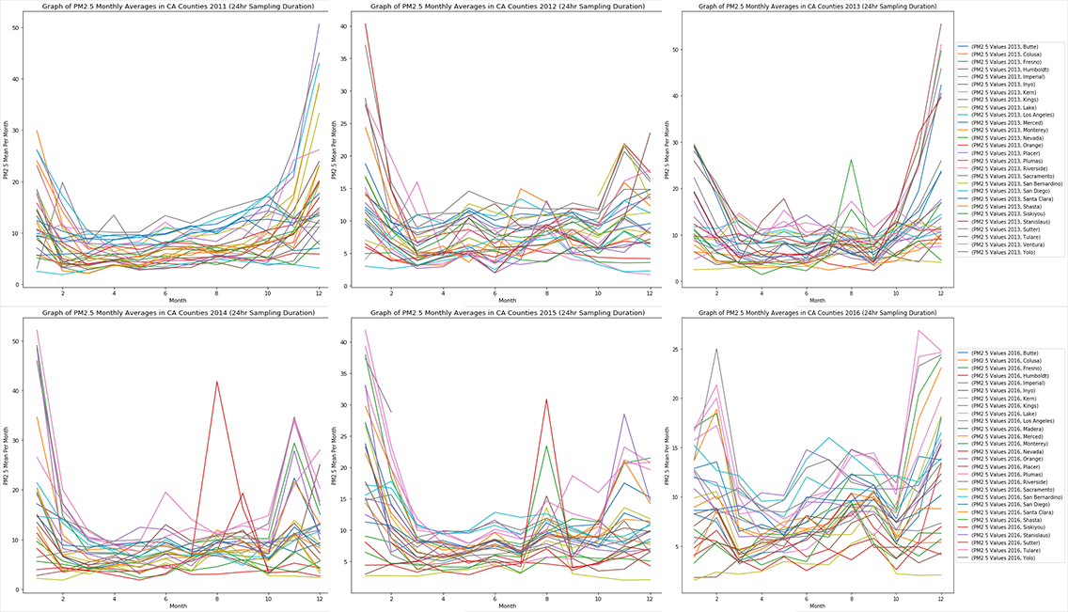

Slide 14
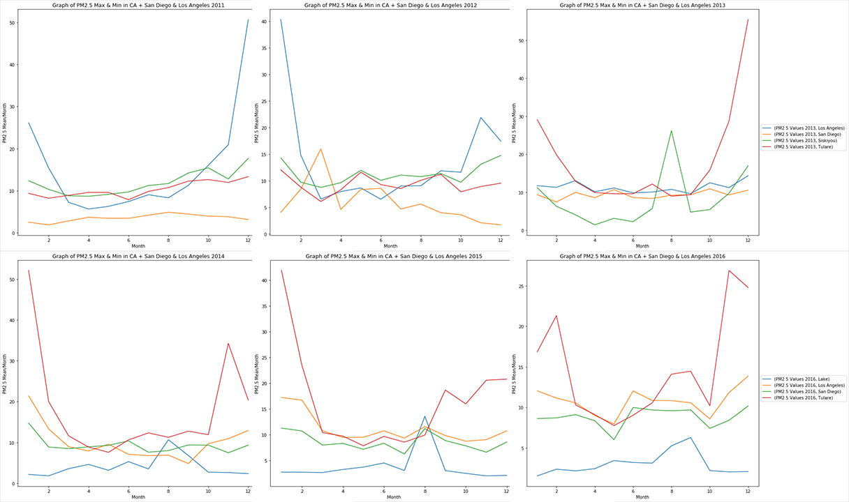

Slide 15
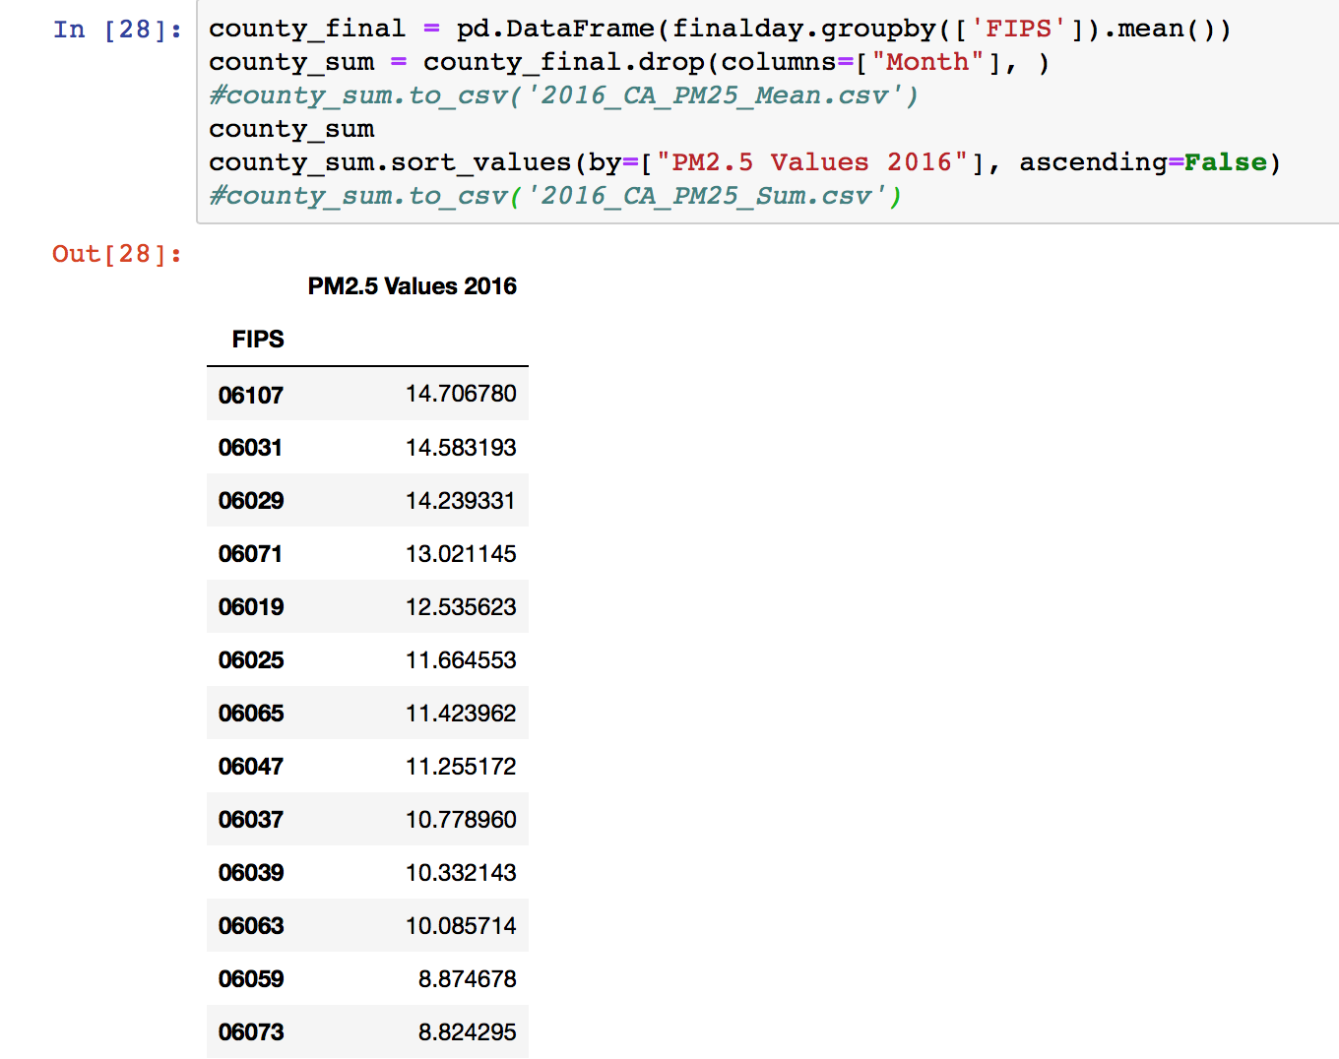
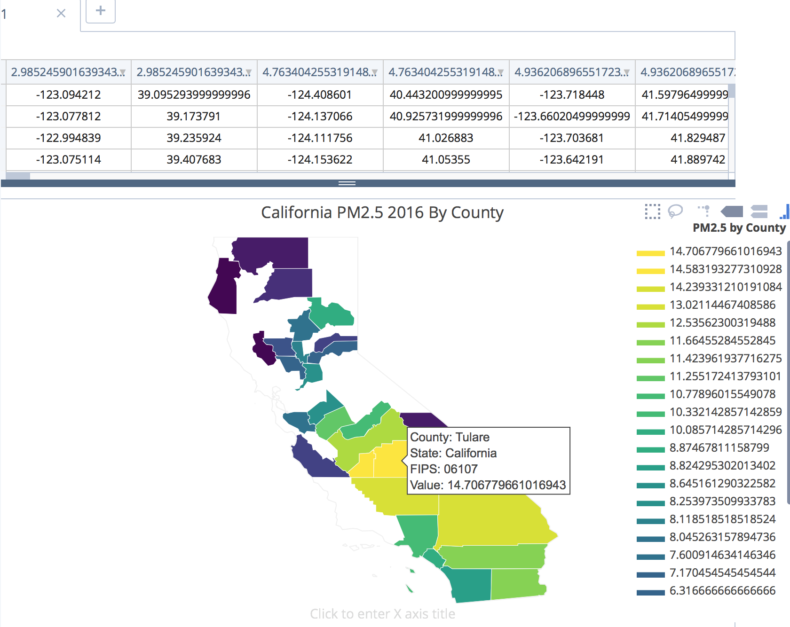
More Cleaning…
-Added California state FIPS code “06” to the front of the County code given from EPA API to make full FIPS code to graph with plot.ly

Slide 16
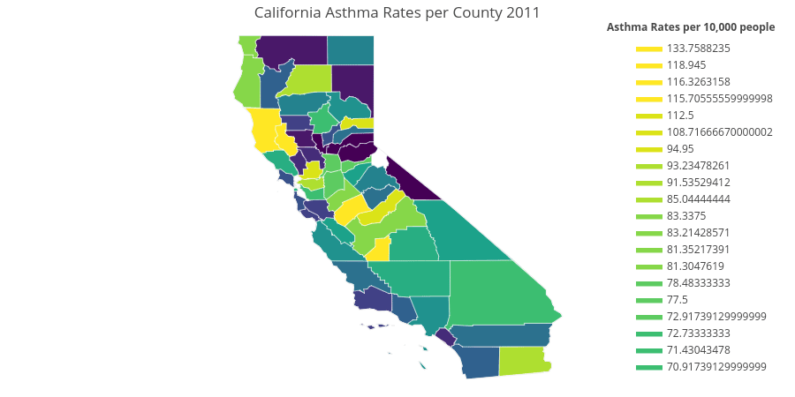
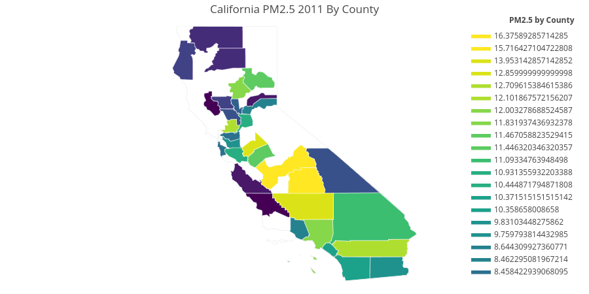
Summary for County PM2.5 visualization by county:
Stay away from: Kings County, Tulare, Kern County, Fresno, Merced if you have a respiratory sensitivity to pollutants.
We found a correlation between the amount of PM2.5 per county and the rate of Asthma Related hospital admissions in people under the age of 18.

Slide 17
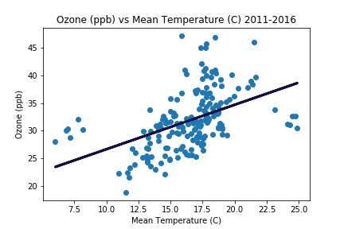

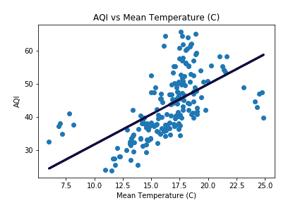

Slide 18
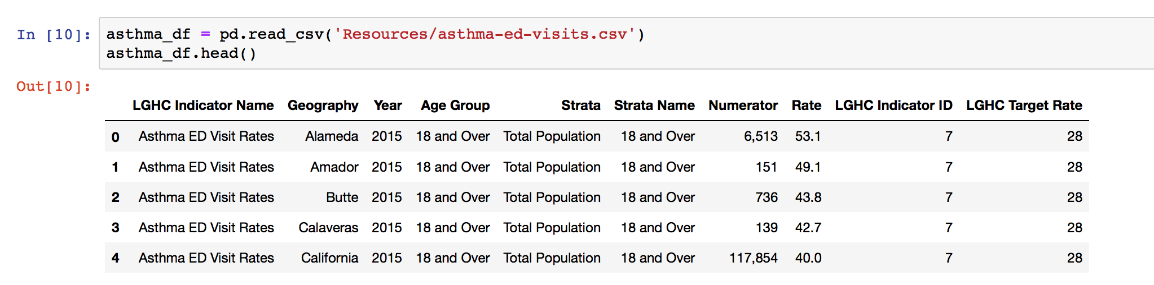
Asthma ED Visit Rates
we chose asthma as an indicator of respiratory health since it can be immediately exacerbated by pollution
data obtained from the California Health and Human Services Agency (CHHS)
contains counts and rates (per 10,000 residents) of asthma (ICD9-CM, 493.0-493.9) emergency department visits among California residents by County and age group (all ages, 0-17, 18+)
the data includes emergency department visits from all licensed hospitals in California

Slide 19
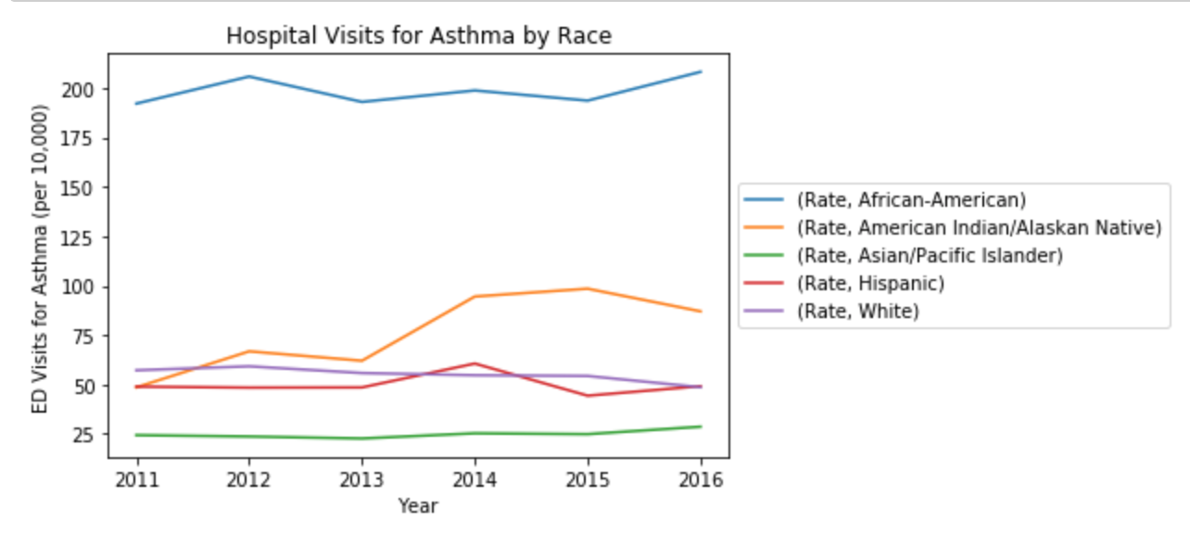
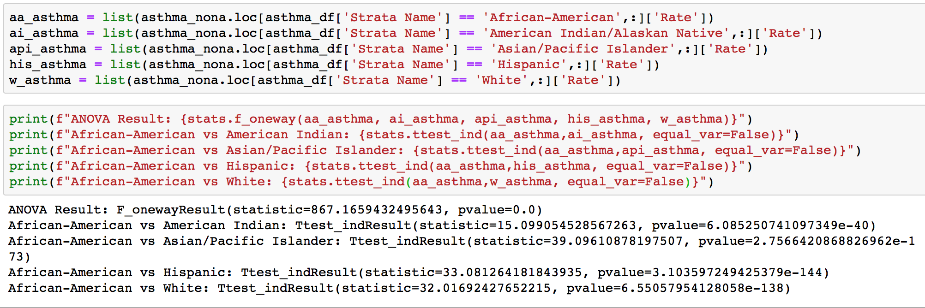
Race Demographics
grouped asthma data by race
found that African Americans visit the ED significantly more for asthma (p<0.05) than any other race group
race analysis is outside of the scope of this project but should be investigated in the future

Slide 20
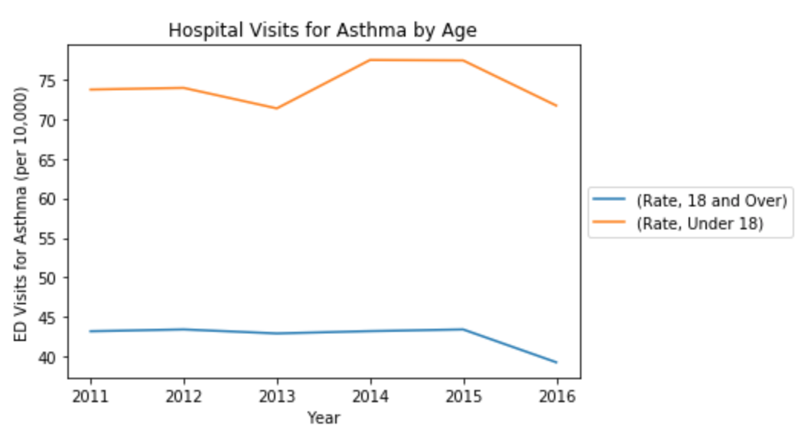
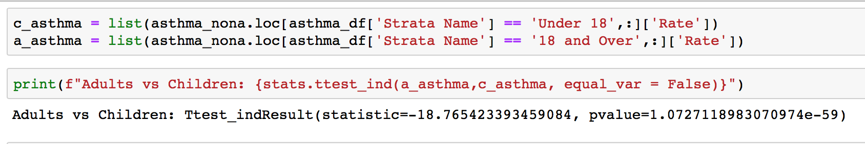
Age Demographics
grouped asthma data by age
found that children visit the ED significantly more for asthma (p<0.05) than adults
divided data between children and adults to observe how pollutants affect these two distinct groups

Slide 21
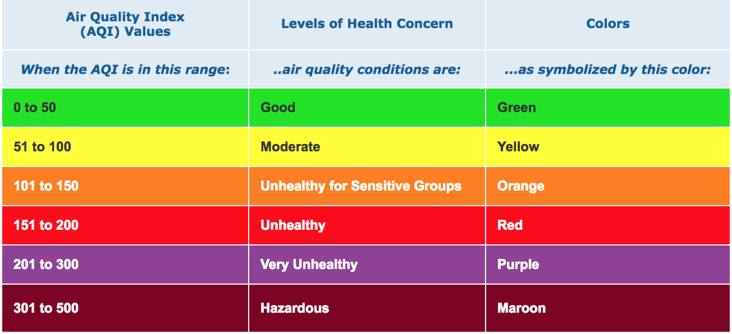
3 parameters to examine:
Ground-level ozone (ppb)
PM2.5: inhalable particles that are less than 2.5 micrometers in diameter
Air Quality Index (AQI)
Index calculated by the EPA to measure air quality
Factors in ground-level ozone, particulate matter, carbon monoxide, sulfur dioxide, and nitrogen dioxide
The higher the AQI, the worse the air quality

Slide 22
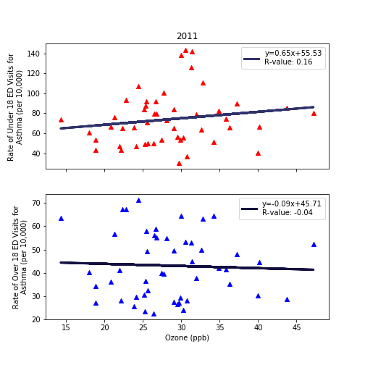
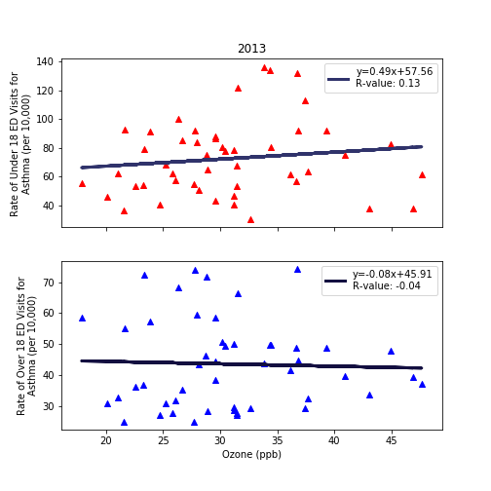
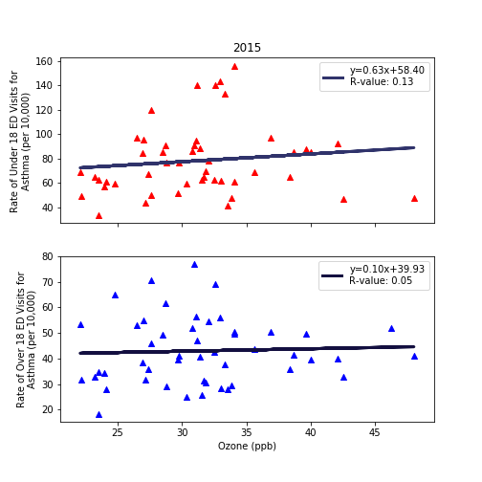
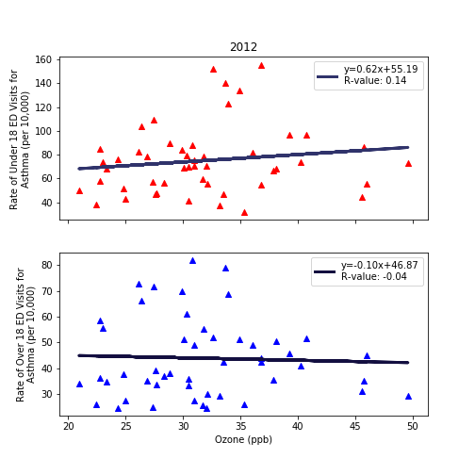
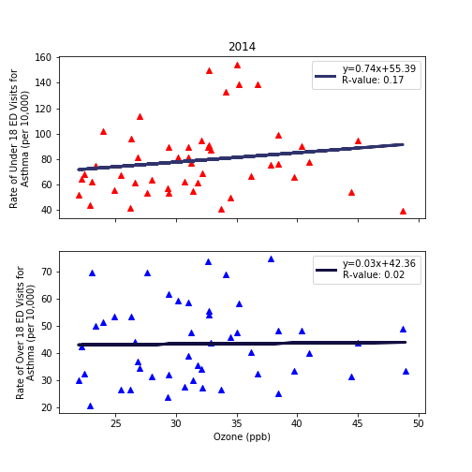

Fig. 1. The ozone concentrations in ambient air across the state of California (2011-2016) and asthma rates per 10,000 individuals admitted during this time. Red triangles: <18yr, blue triangles: >18yr
UCSD Data visualization Bootcamp, DATA20180619
Notes:
Tropospheric ozone is a secondary pollutant, it is not emitted directly but instead is produced photochemically in the troposphere by its precursors such as reactive nitrogen oxide (NOx), CO, CH4 and VOC’s. Life time of an ozone molecule in the troposphere varies according to the photochemical activity ( a mean tropospheric life time is ~22days). Ozone has a longer life time in the free and cold troposphere than warmer boundary layer.
difference between stratospheric and tropospheric ozone generation is in the source of atomic O
for solar radiation with a wavelength of less than 242 nm:
O₂ + hv  O + O
photochemical production of O₃ in troposphere tied to NO_{x} (NO + NO₂)
for wavelengths less than 424 nm:
NO₂ + hv  NO + O
but NO will react with O₃
NO + O₃  NO₂
presence of peroxy radicals, from the oxidation of hydrocarbons, disturbs O₃-NO-NO₂ cycle
NO + HO₂·  NO₂ + OH·
NO + RO₂·  NO₂ + RO·
leads to net production of ozone
The ozone molecule has four resonance structure which imparts or confer a slight polarity to the ozone molecule (0.53D).
The bond length 1.272A is intermediate b/w double bond 1.21A and single bond (H-O) 1.47A {angstroms (A)}.
Protective shield in the stratosphere
Strong oxidant
Secondary pollutant in the troposphere
3rd most abundant GHG with RF +0.3 W.m-2
Damage crops and property
Cause respiratory diseases and premature mortality

Slide 23






Fig. 1. The PM_{2.5} concentrations in ambient air across the state of California (2011-2016) and asthma rates per 10,000 individuals admitted during this time. Red squares: <18yr, blue squares: >18yr
UCSD Data visualization Bootcamp, DATA20180619
Notes:
Tropospheric ozone is a secondary pollutant, it is not emitted directly but instead is produced photochemically in the troposphere by its precursors such as reactive nitrogen oxide (NOx), CO, CH4 and VOC’s. Life time of an ozone molecule in the troposphere varies according to the photochemical activity ( a mean tropospheric life time is ~22days). Ozone has a longer life time in the free and cold troposphere than warmer boundary layer.
difference between stratospheric and tropospheric ozone generation is in the source of atomic O
for solar radiation with a wavelength of less than 242 nm:
O₂ + hv  O + O
photochemical production of O₃ in troposphere tied to NO_{x} (NO + NO₂)
for wavelengths less than 424 nm:
NO₂ + hv  NO + O
but NO will react with O₃
NO + O₃  NO₂
presence of peroxy radicals, from the oxidation of hydrocarbons, disturbs O₃-NO-NO₂ cycle
NO + HO₂·  NO₂ + OH·
NO + RO₂·  NO₂ + RO·
leads to net production of ozone
The ozone molecule has four resonance structure which imparts or confer a slight polarity to the ozone molecule (0.53D).
The bond length 1.272A is intermediate b/w double bond 1.21A and single bond (H-O) 1.47A {angstroms (A)}.
Protective shield in the stratosphere
Strong oxidant
Secondary pollutant in the troposphere
3rd most abundant GHG with RF +0.3 W.m-2
Damage crops and property
Cause respiratory diseases and premature mortality

Slide 24






Fig. 1. The Air Quality Index (AQI) across the state of California (2011-2016) and asthma rates per 10,000 individuals admitted during this time. Red squares: <18yr, blue squares: >18yr
UCSD Data visualization Bootcamp, DATA20180619
Notes:
Tropospheric ozone is a secondary pollutant, it is not emitted directly but instead is produced photochemically in the troposphere by its precursors such as reactive nitrogen oxide (NOx), CO, CH4 and VOC’s. Life time of an ozone molecule in the troposphere varies according to the photochemical activity ( a mean tropospheric life time is ~22days). Ozone has a longer life time in the free and cold troposphere than warmer boundary layer.
difference between stratospheric and tropospheric ozone generation is in the source of atomic O
for solar radiation with a wavelength of less than 242 nm:
O₂ + hv  O + O
photochemical production of O₃ in troposphere tied to NO_{x} (NO + NO₂)
for wavelengths less than 424 nm:
NO₂ + hv  NO + O
but NO will react with O₃
NO + O₃  NO₂
presence of peroxy radicals, from the oxidation of hydrocarbons, disturbs O₃-NO-NO₂ cycle
NO + HO₂·  NO₂ + OH·
NO + RO₂·  NO₂ + RO·
leads to net production of ozone
The ozone molecule has four resonance structure which imparts or confer a slight polarity to the ozone molecule (0.53D).
The bond length 1.272A is intermediate b/w double bond 1.21A and single bond (H-O) 1.47A {angstroms (A)}.
Protective shield in the stratosphere
Strong oxidant
Secondary pollutant in the troposphere
3rd most abundant GHG with RF +0.3 W.m-2
Damage crops and property
Cause respiratory diseases and premature mortality

Slide 25



Cumulative data (2011-2016) for all counties
Conclusions
stronger correlation exists between pollutant concentration and asthma rates for children than for adults
the strongest correlation exists for PM2.5
interesting finding because AQI factors in PM2.5

Slide 26

Why is there a stronger correlation for children?
According to the Office of Environmental Health Hazard Assessment (OEHHA), children are more susceptible to health effects of air pollution for a variety of reasons:
children may have greater exposure than adults to airborne pollutants
they breathe more rapidly
they breathe through their mouths
they spend more time outdoors, especially when pollution is highest
the immune system of children is not fully developed
since the immune system is immature, it can take less exposure to a pollutant to trigger an asthma attack
irritation or inflammation caused by air pollution is more likely to obstruct their narrower airways

Slide 27


Cumulative data (2011-2016) for all counties and
population demographics
Ambient air PM2.5 and Asthma rate <18 (red squares) and >18 >18yr in the state of California.
Asthma rates sorted on the basis of population demographics from 2011-2016 in the state of California.

Slide 28



Conclusions:
“Higher Temperature is associated with high ozone and PM_{2.5} which in turn is linked to health issues”
Finding direct and real answers with Real Time Data Analysis is a real science!
Thanks to
Sandip, Chris, Jake, Eric and all classmates
UCSD Data visualization Bootcamp, DATA20180619

